Slide 1
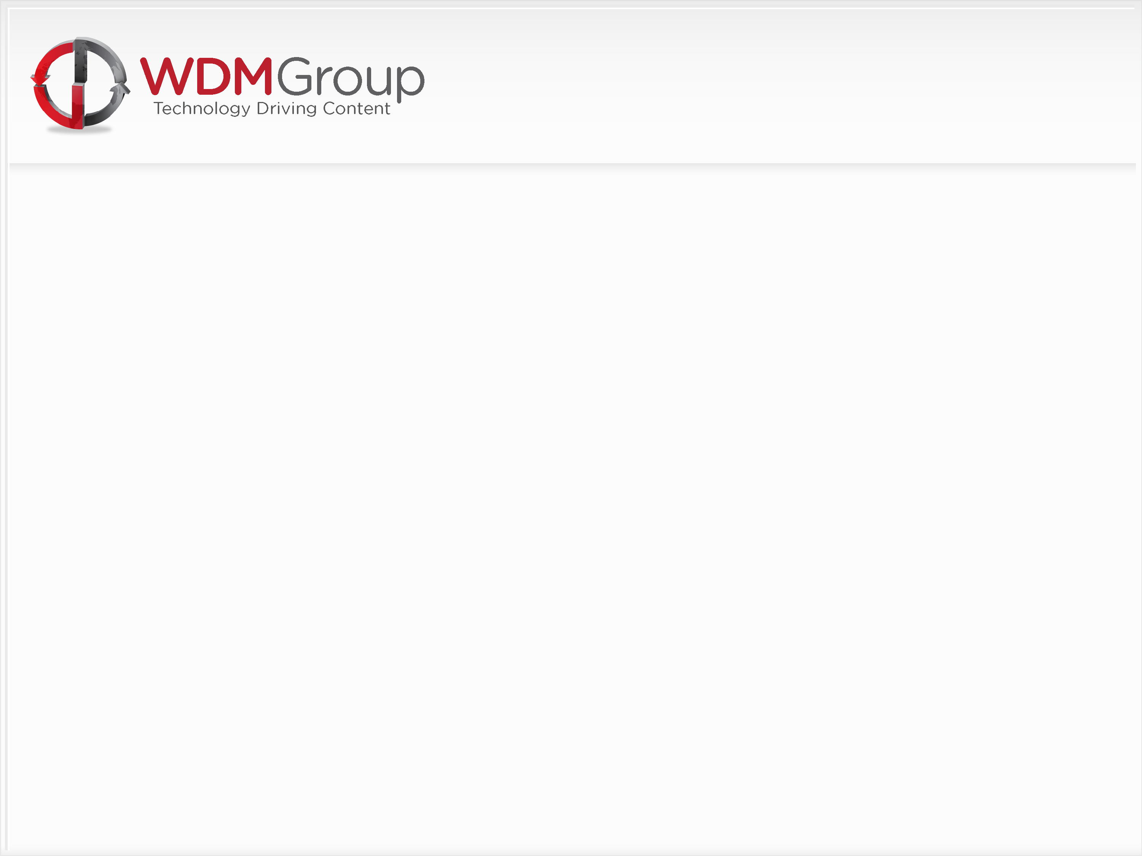
Profile Sales Introduction
For Editorial, Finance, Marketing & Design

Slide 2
The WDM Group
Who Are We?

Slide 3
The History Of WDM Group
Established January 2007.
Four Call Centre’s opened within 32 month followed by period of rapid expansion.
San Diego / Toronto / Boston / Norwich
Mumbai Opened October 2010
Current Group Turnover $12 Million.
Number of Employees: 145.

Slide 4

Mission Statement
To become the leading Global Publisher of Digital Magazines.
To offer our clients a diversity of products.
To provide high quality, relevant and topical news reports to our reader base.

Slide 5
Vision Statement
To develop a vibrant office environment through motivation of our staff.
To demonstrate loyalty to our employees.
To ensure that recruitment, training and development remain a core strategy.
To offer our staff the prospect of development from within the business.
To provide the business with an experienced and professional Management Team.
To offer our clients fast paced web-sites and newsletters.
To generate growth in Web traffic.
To introduce a Social Media Platform which is trusted by Global Business Executives.

Slide 6
What Do WDM Group Do?
What Do We Do?

Slide 7
Profiles Business Model
Revenue Generation through a ‘Vendor Model’
“Sales By Association” – Feature Company Invites
Suppliers
Service Providers
Sub-Contractors
Professional Services
Key Vendors
Vendors participate with Advert + Supplier Profile

Slide 8
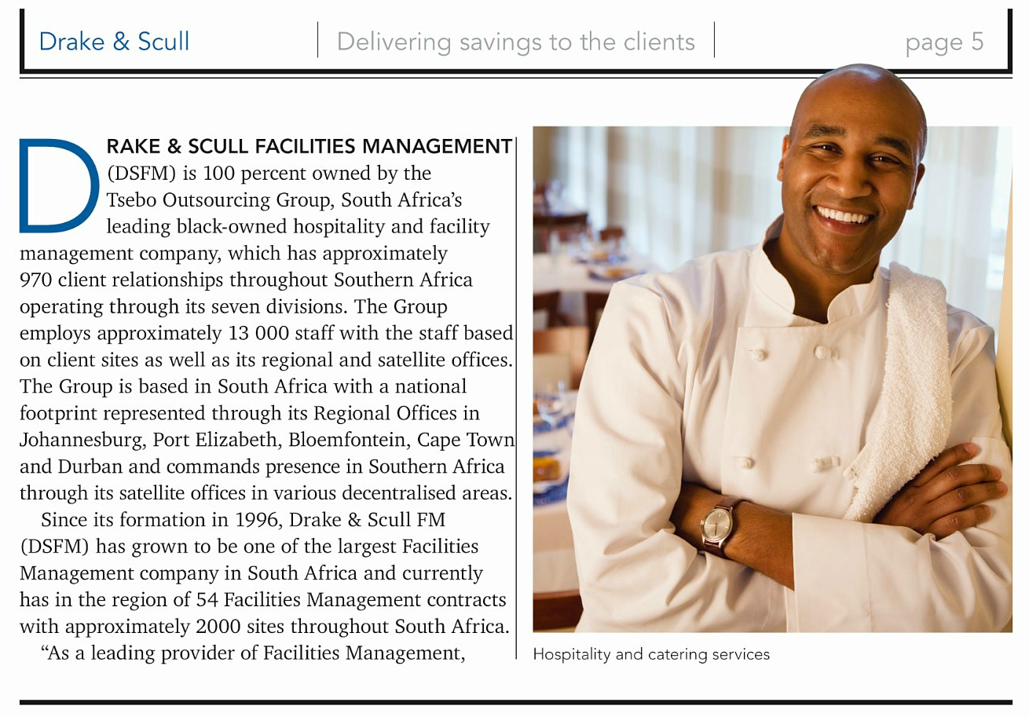
Profiles Business Model
Examples

Slide 9
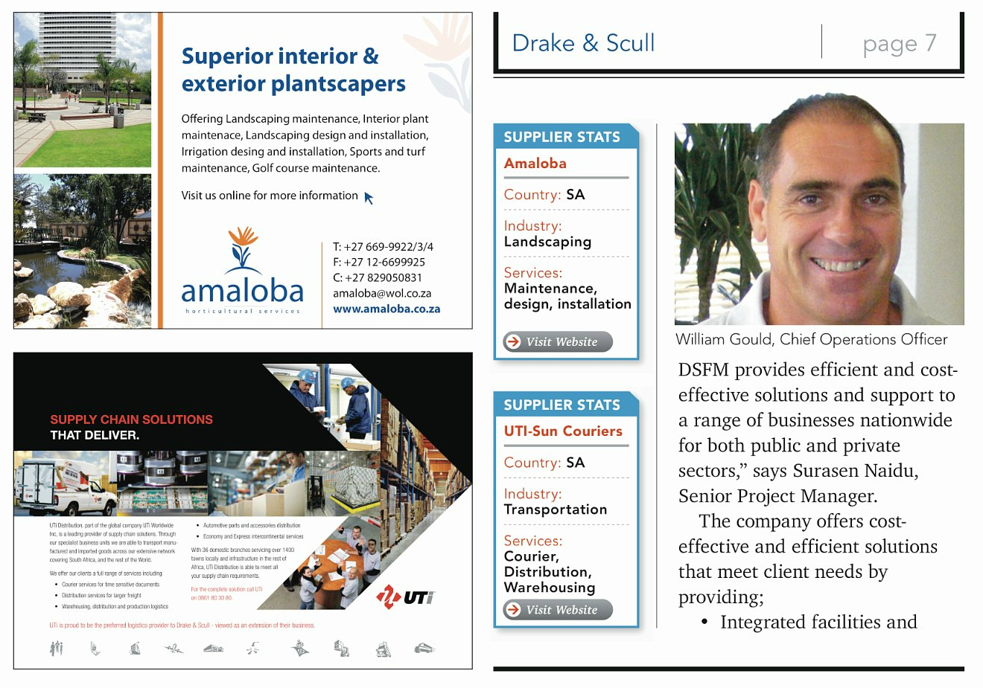
Profiles Business Model

Slide 10

Profiles Business Model

Slide 11
Attitude & Application
Positive Motivation from Management
Positivity from all Call Centre staff
Hunger and Desire to succeed
Work Ethic – 2 to 5 hours a week dedicated to Research and Lead generation – without fail!
Team Players at all times
Research Directors to strive for £15,000/$24,000 plus per month
Projects Directors to strive for £7,500/$12,000 personal revenue per month
Hit your Activity and LHA targets and the rest will fall into place!

Slide 12
Preperation
Understand Sector/Territory – Spidergram & iGram
Understand Production Schedule
Editorial calendar – “Putting the spotlight on...”
Interest in the latest news – Set up Google alerts for one off ‘hot’ leads
Use own industry website for latest news and ‘hot topics’
3 Month Planners – Require a minimum 6 Associations and/or Exhibitions, Media Partner contact details, 500 + available Leads and 3 Strong Angles per project
Lead Spreadsheet Management – To comply with the company standard spreadsheet and emailed weekly – All relevant/highlighted fields to be complete

Slide 13
Activity
Daily Activity:
4 Sessions
3 Hours
100 Calls
Session 1: – 40 Calls, 1 Hour and at least 1 Suspect
Session 2: – 25 Calls, 45 Mins, at least 1 Prospect
Session 3: – 40 Calls, 1 Hour and aim for another Suspect!
Session 4: – Whatever you need to do to hit your daily targets – 25 Calls & 30 Minutes minimum!

Slide 14
Suspect (Background Research)
Session 1 & 3 Suspect Bonanza!
Lead Spreadsheet, Suspect Pad & Telephone only!
No other distractions!
Aim to get through to at least 1 decision maker per session (8 per week)
Engage them and introduce the opportunity – Hooks & Angles
Top Floor to Shop Floor – Who are they? What do they do? Where are they spending/investing? Interesting article?
1 Suspect (minimum), hand written, everyday with an appointment to follow up and Prospect the next day (Cold Edit – 4 Prospects per week)

Slide 15
Suspect (Background Research)
Engage the decision makers only, not marketing or sales executives
Upbeat introduction full of energy and enthusiasm
Use of ‘ice breakers’ and a sense of humor - They are the tour guide to their WDM experience!
Build a personal/professional relationship
Ask intelligent questions and make detailed notes using the TF2SF strategy
Highlight emphasis of editorial meeting in decision making process
Close the suspect with a timeframe commitment for the Prospect
Send Suspect Follow Up email inc. links to suitable examples and the relevant website or magazine along with any testimonials available

Slide 16
Prospect (Cold Edit)
Re-establish relationship quickly and talk through the positive editorial decision, why the coverage fits for the readership and in line with our media partnerships
Explain the similar features recently completed, did they see your email and the magazine/website?
Confirm the interview procedure – Not time consuming, at their convenience and full editorial control
Company Profiles – where it goes and what they get as part of the major marketing exposure – Introduce 2nd magazine through our ‘Business Review’ channel
Product Explanation – fantastic exposure to an executive level readership as well as the production of a bespoke, corporate brochure, website archives, SEO and social networking opportunities
The digital corporate brochure delivery in PDF as a minimum 10 page customized brochure and the use of our innovative page turning technology improving their website users experience – A big chunk of their marketing budget if paid for or delivered by an agency!

Slide 17
Summary
A dedication to Research, Marketing & Preparation outside of the office – LHA’s
A clear, concise, professional telephone manner and dedication to hitting Activity KPI
An understanding of the territory, marketplace and an engaging introduction using ‘Hooks’ such as Association/Exhibition Media Partnerships
Intelligent Questioning – Use of TF2SF to engage the decision maker and begin Editorial background research – Useful in creating buy in as well as understanding investments.
Time Management – Call back scheduled in order to carry out Prospect ‘Supplier Close’
Strong ‘Sales’ ability in order to handle any objections at Prospect stage
Clear, concise timelines put in place for Interview, Letterhead and List delivery
Quality Control – Qualification of all ‘Sales leads’, Admin to prepare invites ‘Endorsement Letter’ and Cold Edit to be passed to Editorial Projects Manager once ‘Sold’.

Slide 18

James Pepper Group Training & Development Manager Email: james.pepper@wdmgroup.com Direct Line: 0044 (0)1603 217544 Fax: 0044 (0)1603 617082
View all of our products at our corporate site: WDM Group www.wdmgroup.com
112-114 Grosvenor House | Prince of Wales Road | Norwich | NR1 1NS

